Slide 1
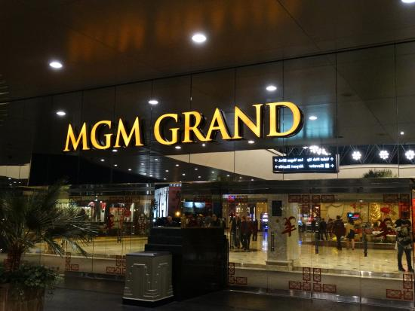
Slots, Tables and all that Jazz….
Managing Customer Profitability at the MGM Grand Hotel
Dushyant Bhavsar

Slide 2
Summary – Bird’s Eye view of the MGM Casino Business

Slide 3
Nature of Problem getting solved-
How the non-gaming leisure and entertainment business, long considered in Vegas to be secondary to gaming, could be exploited independently and profitably.
How this can be solved-
Non-gaming activities at the MGM Grand were highly profitable enterprises, but their customers were not fully understood.
They need to capture non-gaming customer profitability in order to improve overall profits.
They would need to know how much of the profitability in the non-gaming sectors was driven by gamblers and by their families, and how much of it was driven by the non-gaming customer segment.
Actionable insights -
By studying above statistics they surely can value add to current business by unveiling actionable insights such as–
To maximize profit, should they deploy rewarding techniques like in gaming to non-gaming sectors?
Also, could improved tracking and rewarding of non-gaming customers be implemented without negatively impacting profitability?
Further to summaries case-
It is evident from case study that, Las Vegas has always been an internationally acknowledged gambling destination.
From Exhibit for span 1996 to 2004, the avg. gambling budget per customer for given span of years has remained steady.
The non-gaming leisure and entertainment related customer spending’s has exponentially increased and for MGM this is an opportunity of profit maximization.
Tools to study the data-
From the hotel folio - The RFM (Recency, Frequency and Monetary) model employed to study each customer based on how recently has a customer visited the casino. Frequency how many times in a year has the customer visited and Monetary is indication of Money spent by customer.
Understanding the CLV for non-gaming customers and identify profitable customers.
Missing data fields that would have enhanced business understanding-
Non-gaming profit calculation: The Information on non-gaming expenditures was less exhaustive than gaming information. It included information only from the hotel folio (expenditures customer had charged to the room) and has information from 2003 onwards.
What all types of industries have and use this range of attributes- Hotel, Gaming and Airline industries will have this data and can use the attributes to track customers to increase their profitability by providing them offers and attracting them.

Slide 4
High Level MGM Revenue summary
Segregating the MGM Business revenue split w.r.to Gaming, non-Gaming and both
EARNINGS | Amount | %
Earnings from Casino Only customers | $ 1,42,75,805.69 | 25.22
Earnings from Hotel Only customers | $ 3,46,20,053.99 | 61.16
Earning from Hotel +Casino customers | $ 77,09,256.80 | 13.62
Total Earnings | $ 5,66,05,116.48 | 100.00
The Earnings from the Non Gaming customers is 61% as compared to the gaming customers which is 39%.
Therefore it is evident that the Non gaming activities at MGM Grand are highly profitable.

Slide 5
Overall Revenue Analysis For Non Gaming from 2002-2005
Segregating the MGM Non-gaming Business revenue
TOTAL_CHARGES | Room | OTHER | ENTERTN | RETL | FNB
$6,92,40,107.98 | $1,81,13,025.94 | $4,77,94,988.24 | $29,32,114.12 | $7,706.68 | $ 3,92,273.06
From the above distribution it is clear that in the maximum profit was gained from the category OTHERS which are 69%. Hence it is important for MGM Grand to understand their non-gaming customers to improve and continue future benefits from them.

Slide 6
RFM Analysis for Non gaming customers
R/FM | 1 | 1.5 | 2 | 2.5 | 3 | 3.5 | 4
5 |  |  | $5,097.87 | $21,442.34 | $1,854.72 | $8,585.66
4 |  |  | $7,784.33 | $18,905.45 | $1,00,35,294.87 |  | $2,103.58
3 |  |  | $14,237.37 | $17,133.27
2 | $21,372.80 | $5,32,644.72 | $1,05,852.08 | $33,403.95 | $1,08,59,619.28 | $4,243.95
1 | $19,712.03 | $5,68,921.20 | $1,21,215.98 | $35,087.71 | $1,21,75,552.22 | $9,988.61
Total | $41,084.83 | $11,01,565.92 | $2,54,187.63 | $1,25,972.72 | $3,30,72,321.09 | $22,818.22 | $2,103.58
.
Customer Category | R | F+M Score | Total Monetary Value
High Spenders | 1-4 | 1.5 - 3 | $ 3,43,99,100.35
Medium Spenders | 1-5 | 1 -2.5 | $ 1,81,294.92
Low Spenders | 1-5 | 2-4 | $ 39,658.72

Slide 7
RFM Spread for Non gaming customers
.

Slide 8
Overall Revenue Analysis For Non Gaming from 2002-2005
Views–
The Overall Earnings for MGM Grand from the Non Gaming customers is 61% as compared to the gaming customers which is 39%.
Therefore it is evident that the Non gaming customers at MGM Grand are most profitable.
As revealed from slide 5 analysis, 69% of non-gaming profit was gained from the category OTHERS and MGM currently do not track any.
from all above, we can conclude that, If MGM wants to value add to their current business then, they need to enhance non gaming customer business understanding.
Once we have enough understanding of non-gaming customers, we can derive further actionable insights by applying various statistical methodologies on it.

Slide 9
Appendix
Excel Workout Sheet:

Slide 10
THANK YOU!!

